Slide 1
INTRODUCTION TO MARKETING
0
Chapter 3
The Cultural
Environment
NGUYEN THI PHUONG*
THANG LONG UNIVERSITY
*MA in Global Marketing, PHD in Economics

Slide 2
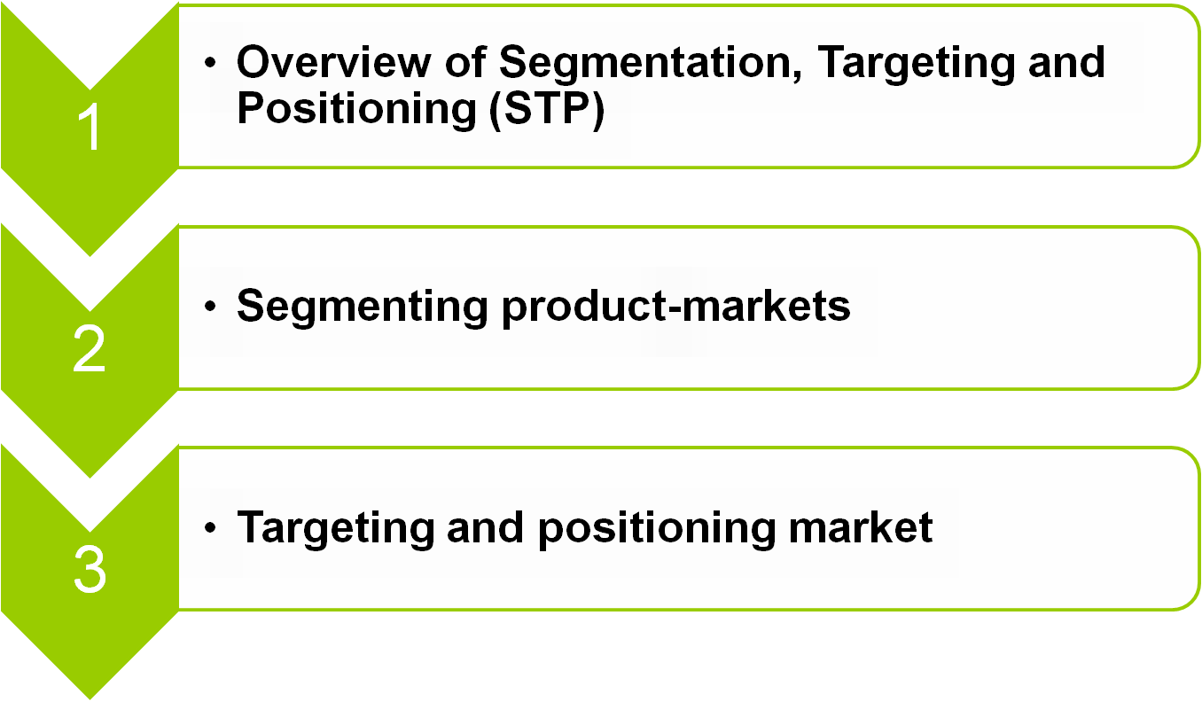
SESSION 6: Segmentation, targeting, and positioning
Copyright © 2011 Pearson Education
15-<number>

Slide 3
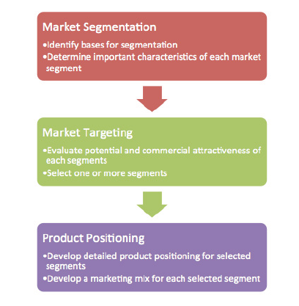
6.1 Overview of Segmentation, Targeting and Positioning (STP)
STP is a familiar strategic approach in Modern Marketing.
Copyright © 2011 Pearson Education
15-<number>

Slide 4
STP focuses on commercial effectiveness, selecting the most valuable segments for a business and then developing a marketing mix and product positioning strategy for each segment.
Copyright © 2011 Pearson Education
15-<number>

Slide 5
6.2 Segmenting product-markets
Market segmentation is a two-step process of (i) naming broad product-markets and (ii) segmenting these broad product-markets in order to select target markets and develop suitable marketing mixes.
Segmenters aim at one or more homogeneous segments and try to develop a different marketing mix for each segment.
Copyright © 2011 Pearson Education
15-<number>

Slide 6
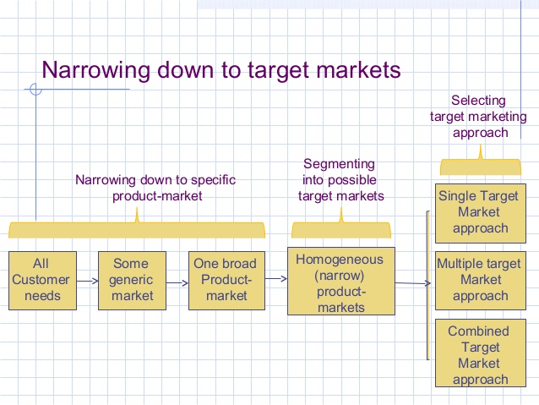
Marketers must break apart all possible needs into some generic markets and broad-product-markets
Copyright © 2011 Pearson Education
15-<number>

Slide 7
The single target market approach: segmenting the market and picking one of the homogeneous segments as the firm’s target market
The multiple target market approach: segmenting the market and choosing two or more segments then treating each as a separate target market needing a different marketing mix
The combined target market approach: combining two or more submarkets into one larger target market as a basis for one strategy
Copyright © 2011 Pearson Education
15-<number>

Slide 8
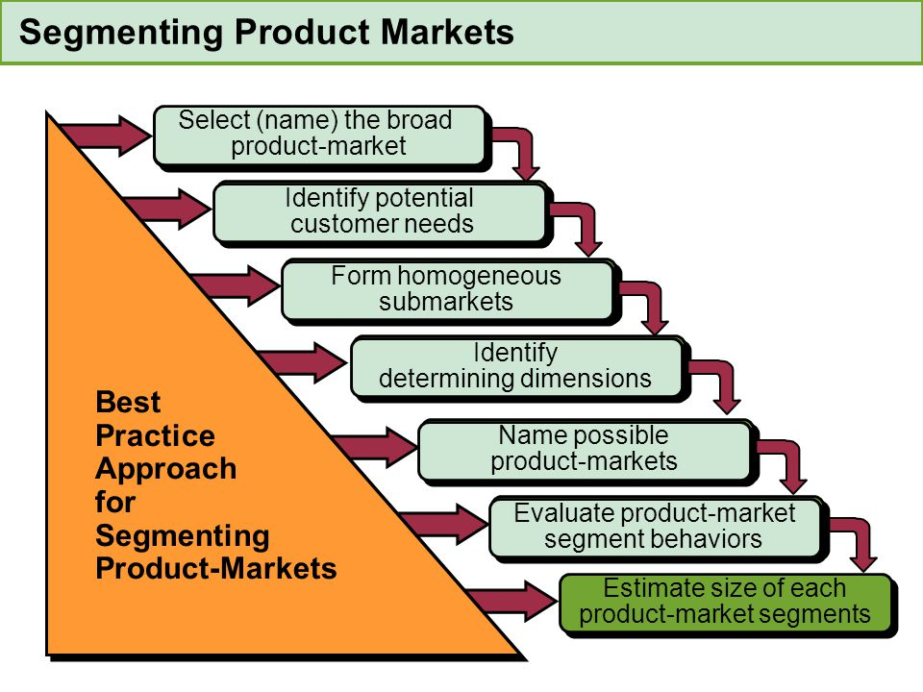
Approach for segmenting product-markets
Copyright © 2011 Pearson Education
15-<number>

Slide 9
Step 1: First, decide what broad product-market the firms want to be in. This may be started in the firm’s objectives
Step 2: Identify potential customer’s needs and consider all of the potential customers in the broad product-market
Step 3: Assuming that some people have different needs than others, form different submarkets based on each submarket’s specific needs.
Copyright © 2011 Pearson Education
15-<number>

Slide 10
Step 4: Review the list of need dimensions for each possible segment and identify the determining dimensions.
Step 5: Name possible product-markets. A market grid is a good way to help visualize this broad product-market and its narrow product-markets
Step 6: Evaluate why product-market segments behave as they do
Step 7: Make a rough estimate of the size of each product-market segment
Copyright © 2011 Pearson Education
15-<number>

Slide 11
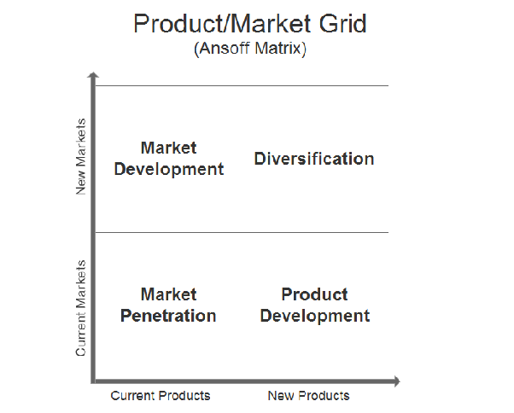
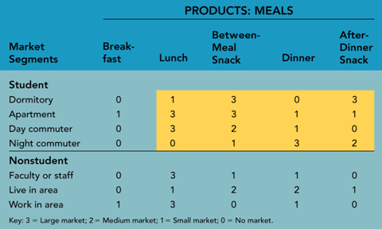
Market Grid example
Copyright © 2011 Pearson Education
15-<number>

Slide 12
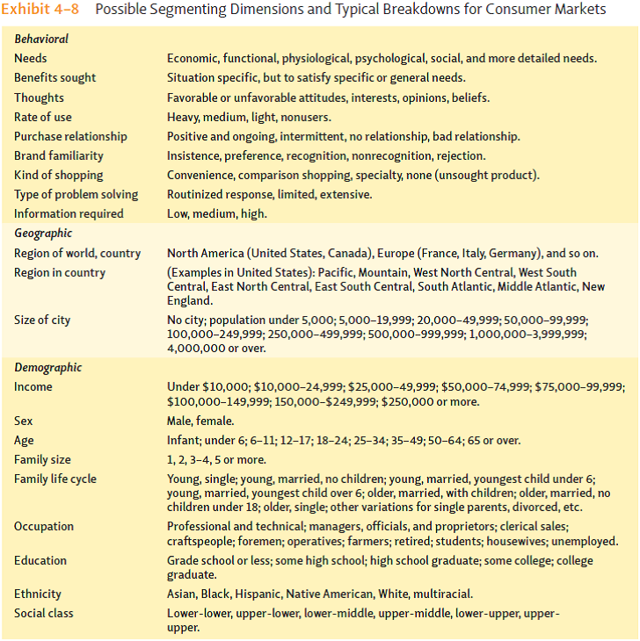
Possible segmenting dimensions
Copyright © 2011 Pearson Education
15-<number>

Slide 13
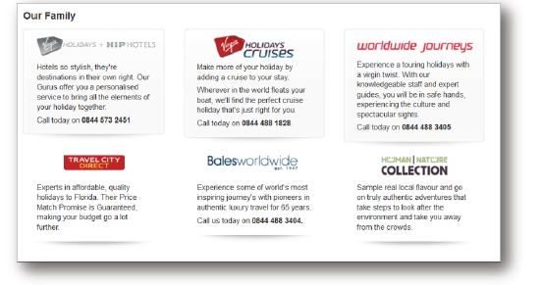
An example is Virgin Holidays who segment holidays into 6 groups.
Question 1: ways to segment by demographic and geographic of car product?
Copyright © 2011 Pearson Education
15-<number>

Slide 14
6.3 Targeting and positioning market
a. Targeting market
A target market is the market a company wants to sell its products and services to, and it includes a targeted set of customers for whom it directs its marketing efforts
target markets are typically segregated by age, location, income and lifestyle.
Copyright © 2011 Pearson Education
15-<number>

Slide 15
Testing of the target market often occurs in a phase before the product release.
Once a product is released, the company can continue to monitor the demographics of its target market through sales tracking, customer surveys and various other activities
Copyright © 2011 Pearson Education
15-<number>

Slide 16
b. Positioning
refers to how customers think about proposed or present brands in a market
Positioning are especially important when competitors in a market appear to be similar
Managers make the graphs for positioning decisions by asking consumers to make judgments about different brands
Copyright © 2011 Pearson Education
15-<number>

Slide 17
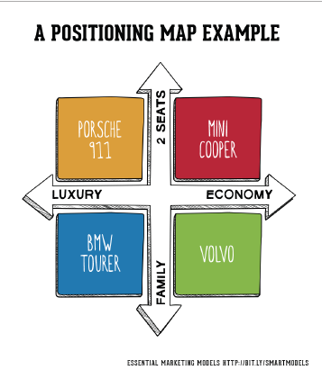
Positioning maps (or perceptual map) are the last element of the STP process. If there were no products in one segment it could indicate a market opportunity.
Copyright © 2011 Pearson Education
15-<number>

Slide 18
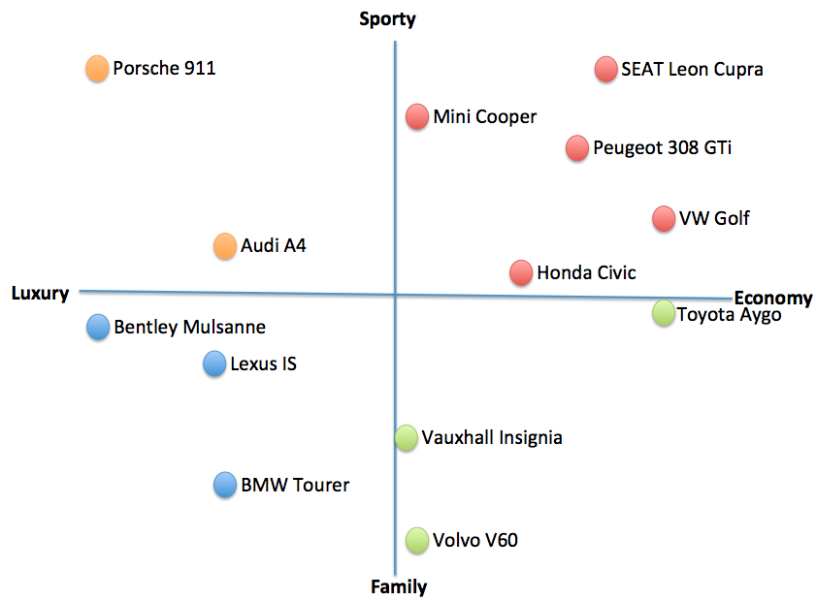
Copyright © 2011 Pearson Education
15-<number>

Slide 19
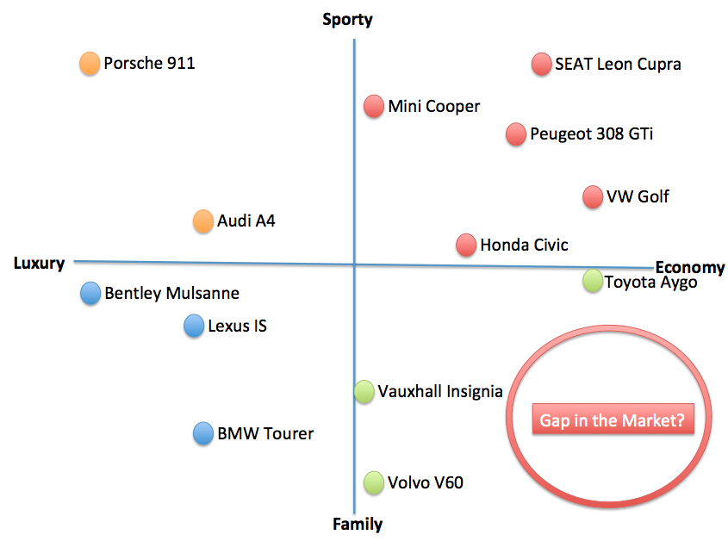
A product positioning map to analyze your own businesses current position in the market, and identify opportunities
Copyright © 2011 Pearson Education
15-<number>

Slide 20
Homework
1. Explain what market segmentation is
2. Construct perceptual map of shampoo and define gap in the market of Vietnam
Copyright © 2011 Pearson Education
15-<number>

